Slide 1
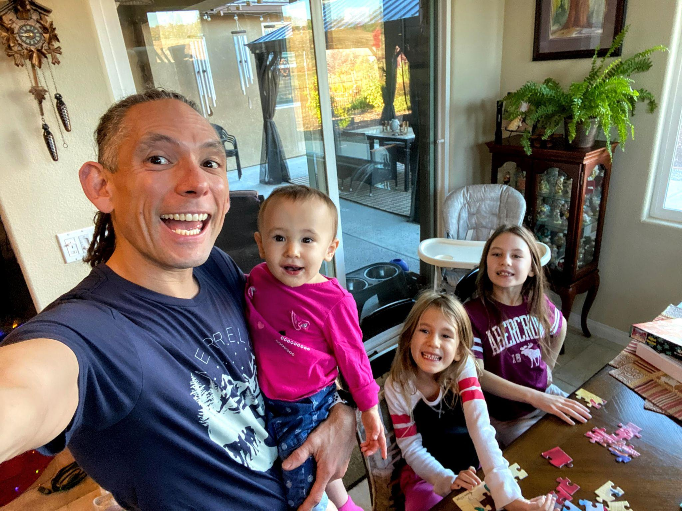
About Me
Close to 20 years in the industry
Passionate about Operational Excellence, mentoring & growing others
Strong advocate for DEI&B and have led multiple initiatives in previous roles.
Always Learning!

Slide 2
Assumptions
Siloed Functions (Dev / Ops / QA)
Waterfall model
Poor Visibility
Lack of Alignment & Prioritization
Horizontal Architecture (UI / API / Data)
Top Level Biz Goals:
Operational Effectiveness
Increase customer satisfaction
Notes:
Modern IT: A Necessity, Not an Option
Visualizing Transformation: Before and After DevOps
The Power of DevOps & ROI
DevOps Maturity & The Flywheel
Your Customized DevOps Roadmap
Zooming In: Our Initial Engagement
Addressing Your Pain Points
Immersive & Interactive Training: Dojos
The Power of Cloud and Containerization
Next Steps: Walking the Transformation Path
Why Choose Us: The Bottom Line
Q&A

Slide 3
Agenda
A tale of modernization & a vision for the future
How we can get there together
Next Steps
Q&A
Notes:
Modern IT: A Necessity, Not an Option
Visualizing Transformation: Before and After DevOps
The Power of DevOps & ROI
DevOps Maturity & The Flywheel
Your Customized DevOps Roadmap
Zooming In: Our Initial Engagement
Addressing Your Pain Points
Immersive & Interactive Training: Dojos
The Power of Cloud and Containerization
Next Steps: Walking the Transformation Path
Why Choose Us: The Bottom Line
Q&A

Slide 4


Enterprise IT Transformation: Your DevOps Journey with Us
December 14, 2023
Notes:
A tale of modernization & a vision for the future
How we can get there together
Next Steps
Q&A

Slide 5
Modern IT: A Necessity, Not an Option
1
2
3
Traditional IT is becoming obsolete in the face of rapid technological advancements and changing business needs.
The shift to modern IT, including cloud adoption and containerization, is essential for staying competitive and agile.
DevOps is the cornerstone of modern IT, enabling seamless collaboration between development and operations teams.
Notes:
<Emphasize the urgency of embracing modern IT practices and highlight how DevOps is the key to a successful transformation. Tailor the discussion to address the specific pain points and goals of the client.>
Adapt or Die
Kodak, Blockbuster,
Walmart: Walmart adopted DevOps practices to improve their online shopping and e-commerce platforms. Their transformation enabled them to compete effectively with e-commerce giants like Amazon.
Target: The retail giant, Target, implemented DevOps to improve their online shopping experience. This transformation resulted in faster feature delivery and a 50% reduction in incidents during peak shopping periods.

Slide 6
ROI of DevOps Transformation
50%
30%
60%
20x
Employee Productivity Increase
Operational Costs Reduction
Software Quality Improvement
Deployment Frequency Increase
*State of DevOps report 2021
Notes:
Cost savings / efficiency
Agility / TTM
Scalability / Performance
Innovation and competitive edge
Risk mitigation / reliability
Cultural Transformation
Customer Satisfaction / Retention
Security & Compliance
Key Metrics
DevOps Lead Time: The average time it takes to go from code commit to code successfully running in production.
Change Failure Rate: The percentage of changes that result in a service impairment or outage.
Deployment Frequency: How often code is deployed to production, in a given period.
Mean Time to Recover (MTTR): The average time it takes to restore service after a service impairment or outage.

Slide 7
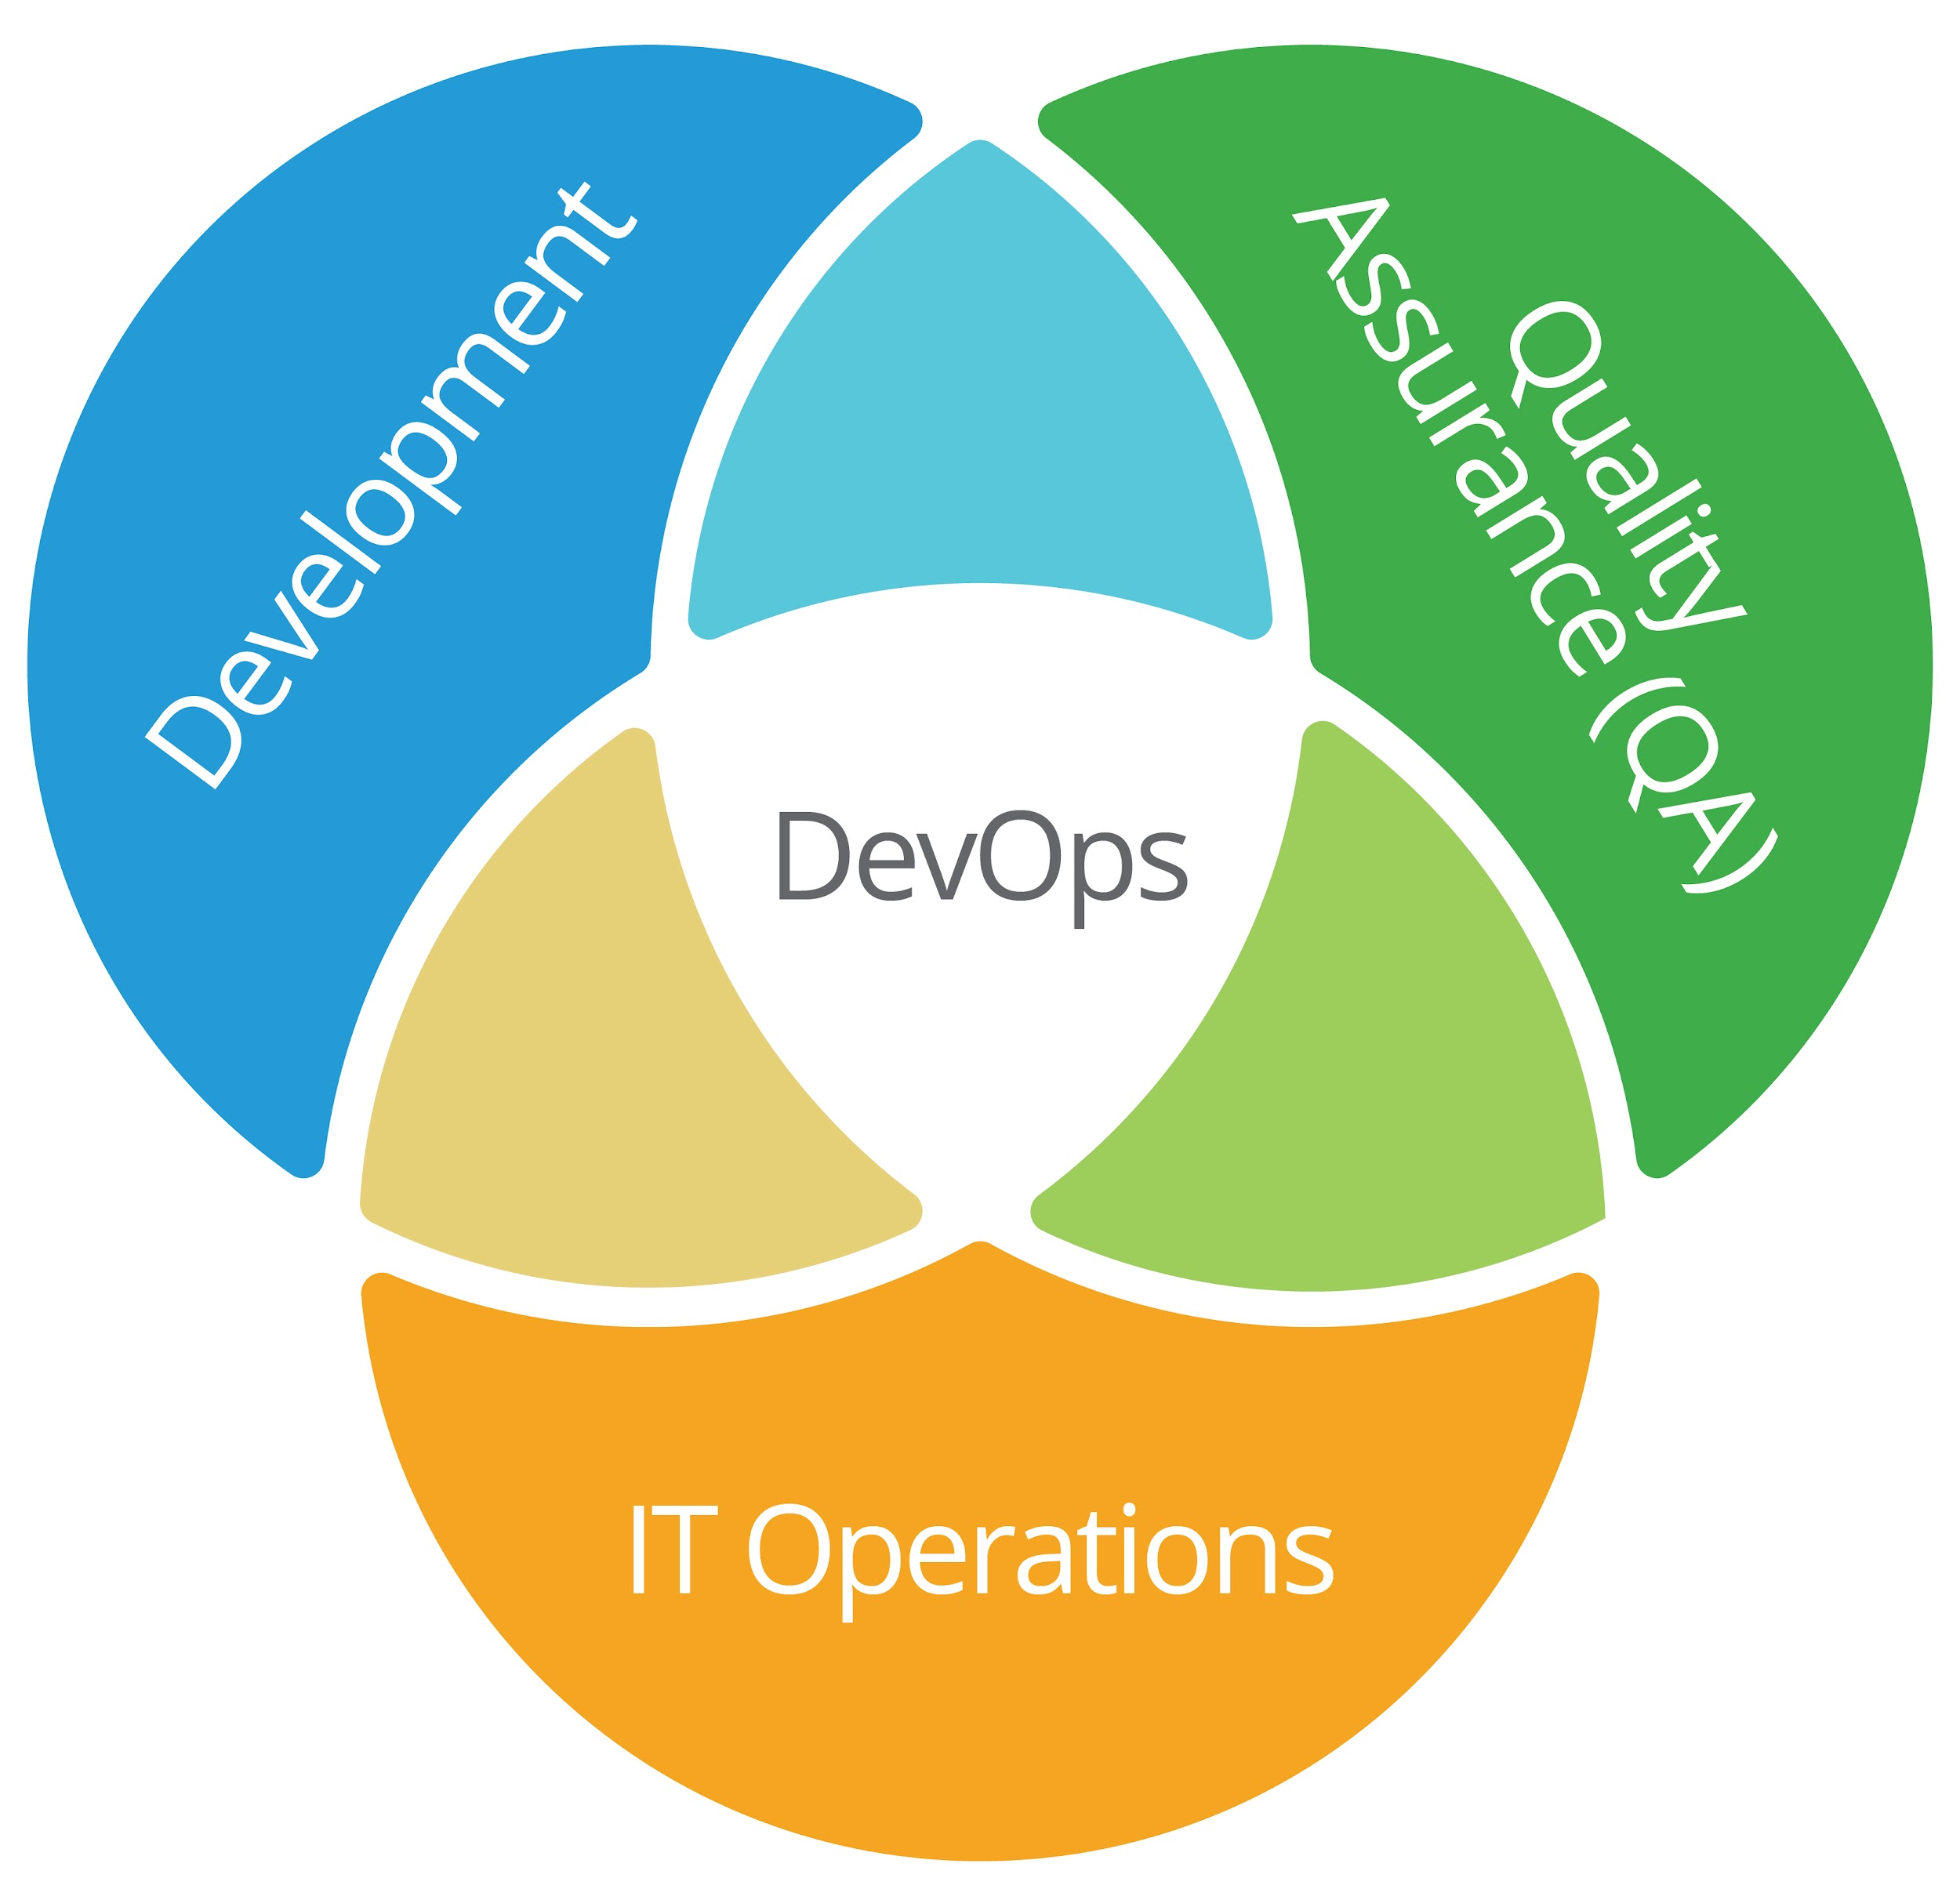


Maturing your Organization for Success
DevOps Maturity Model
The Flywheel Effect
Collaborative Evolution
Initial Stage
Defined Stage
Managed Stage
Optimized Stage
Building upon learnings and sharing successes inevitably lead to more teams and business units eager to improve their own delivery and innovation
DevOps is about continuous improvement. Building upon collaborative successes results in increased ROI
Notes:
Understanding the phases of DevOps maturity: from cultural shift and automation to continuous delivery and feedback.
<Customize the content to reflect the specific pain points and goals of the customer. Emphasize the potential for collaborative evolution and growth throughout the presentation.>
<Exploring how DevOps improvements create a flywheel effect, accelerating software delivery and business value.>
<Highlight the collaborative nature of DevOps and its role in evolving software delivery practices>
Initial Level:
Unaware of DevOps benefits.
Follows waterfall project management.
Testing late in development.
Operations separate from development.
No shift-left security.
Repeatable Level:
Understands DevOps principles.
Consistent environments.
Improved collaboration.
Proactive with repeatable processes.
Challenges in managing large features.
Defined Level:
Consistent and standardized processes.
Extensive automation (e.g., database changes, monitoring).
Teams organized around projects.
Clear communication and documentation.
Integration tests as quality gates.
Managed Level:
Effective environment management.
Testing and monitoring in production.
Predictable delivery.
Feedback-driven.
Knowledge management and mentorship.
Open to change for organizational goals.
Optimized Level:
Full automation with testing in production.
Scalable and adaptive systems.
Handles problems like system overload.
High DevOps maturity with automation, scalability, and resilience.

Slide 8
Visualizing Transformation: Before and After DevOps
Before DevOps
After DevOps
Long lead times and cycles for development
Lack of consistency between environments
Frequent downtime during deployments
Quality issues in Production
Efficient environment kickstart
Streamlined development processes
Consistency across environments
No downtime deployments
Notes:
4-6 month milestones
Horizontal teams
Personal offices
Long planning cycles
PM, Dev, Test Yearly customer engagement
Feature branches
20 + person teams
Secret roadmap
Bug debt accumulated
1100 page spec documents
Private repositories
Deep organizational hierarchy
Success is a measure of install numbers
Features shipped once a year
—-
3-week sprints
Vertical teams
Team rooms
Continual Planning & Learning
PM & Engineering
Continual customer engagement
Everyone in master
8-12 person teams
Publicly shared roadmap
Debt paid as incurred
Mockups in PPT
Inner source
Flattened organization hierarchy
User satisfaction determines success
Features shipped every sprint

Slide 9
Your Customized DevOps Roadmap
Phase 1: Assessment & Planning.
Conduct a comprehensive review of current processes, identify bottlenecks and pain points, and design a tailored DevOps strategy.
Phase 2: Pilot Implementation.
Select a non-critical business application as a pilot project for DevOps implementation, focusing on automation and collaboration.
Phase 3: Scale Up.
Roll out DevOps practices across the organization, emphasizing cultural and process changes, supported by automation tools.
Phase 4: Continuous Improvement.
Establish a culture of continuous improvement, leveraging data and feedback to optimize DevOps processes.

Slide 10
Zooming In: Our Initial Engagement
Improving Development Environments and Lead Times
Discovery
Pilot Programs + Teams
Immersive Trainings
Measuring and Debriefing
Our initial focus will be on kickstarting new environments and reducing development lead times. This will lay the foundation for future DevOps practices and efficiencies.

Slide 11
The Power of Cloud and Containerization
Cloud native applications for enhanced scalability and flexibility
DevOps in the cloud for accelerated development and deployment
Containerization for seamless software deployment across environments
Cloud platforms offer the necessary infrastructure for modern software practices
Infrastructure as Code (IaC) for automated and consistent environment provisioning
Container orchestration for managing complex, microservices-based applications

Slide 12
Addressing Your Pain Points
How We Can Help
Kickstarting new environments and long lead times for development will be addressed through automated infrastructure provisioning and cloud services.
Lack of consistency between environments will be solved by implementing infrastructure as code and containerization.
Downtime during deployments and code quality issues will be tackled through continuous integration/continuous deployment (CI/CD) practices and automated testing.
Notes:
Customize the bullet points to specifically address the pain points and needs of the client. Provide concrete examples of how our DevOps solutions can alleviate their challenges.

Slide 13

Dojos: Immersive Training for DevOps
Key Elements of Dojos
Practical simulations in a safe environment
Immersive and interactive training approach
Focus on establishing a DevOps mindset and skill set
Fosters cross-functional collaboration
Notes:
Dedicated Experience for Immersive Learning
Culture: Change in mindset and behaviors for both delivery teams and their leadership
Practices: Teach and reinforce knowledge to shift teams toward modern ways of working
Experimentation: Foster an immersive, distraction-free environment that allows teams to apply experiments and learnings
“The best learning and growth happens only when people apply newly gained skills to their product backlog and are able to break past existing organizational constraints.”
Consider highlighting real-life examples of how Dojos have helped teams address specific pain points and improve their DevOps capabilities. Share success stories and measurable outcomes to demonstrate the effectiveness of this approach.

Slide 14
Next Steps: Walking the Transformation Path
Establish a cross-functional DevOps team, aligning with your internal stakeholders.
Conduct a comprehensive assessment of your current workflows, tools, and processes to identify improvement areas.
Prioritize key areas for quick wins and early successes, such as automating build and deployment processes.
Collaboratively design and implement a phased DevOps adoption plan, integrating feedback loops for continuous improvement.
Notes:
Customize the roadmap to the client's specific needs and goals. Emphasize the collaborative approach and highlight the potential for quick wins and long-term value.

Slide 15
Why Choose Us: The Bottom Line
Expertise in DevOps for Enterprise IT
We specialize in DevOps transformations for traditional on premise infrastructure, with a focus on modernizing product suites and architectures.
Proven Track Record in Software Delivery Evolution
We have a track record of helping companies reduce lead times, increase consistency, and improve code quality.
Collaborative Problem-Solving Approach
We collaborate with your team to identify and solve developer and ops pain points, evolving your software delivery practices.
Notes:
Emphasize the collaborative approach to problem-solving and transformation., Success stories

Slide 16
Q&A
1
2
3
How do you see our initial engagement phase aligning with your current priorities?
In terms of the customized DevOps roadmap, are there any specific areas of your software delivery process that you are most eager to address or improve?
How do you envision the role of our team in addressing the pain points of your developers and operations staff, and what specific outcomes are you hoping to achieve?
Notes:
We are excited about the opportunity to partner with you on this transformation journey.

